Slide 1


Questions and Answers about Questions and Answers:
Lessons from generating, scoring, and analyzing questions in a Reading Tutor for children
Jack Mostow
Project LISTEN (www.cs.cmu.edu/~listen)
AAAI Symposium on Question Generation keynote, Nov. 5, 2011, Arlington, VA
The research reported here was supported by the Institute of Education Sciences, U.S. Department of Education, through Grant R305B070458. The opinions expressed are those of the authors and do not necessarily represent the views of the Institute or the U.S. Department of Education.
Notes:
This talk will review attempts over the years to automatically generate and administer questions in Project LISTEN’s Reading Tutor, to log, score, and analyze children’s responses, and to evaluate such questions. How can a tutor use questions? How can it generate them? How can it score children’s responses? What can they tell us? How can we evaluate questions? Which questions succeeded – or failed?

Slide 2
Questions about Questions
Target: What does it take to answer the questions?
Purpose: Why ask the questions?
Question type: In what form will the questions be output?
Answer type: In what form will responses be input?
Generation: How construct questions, answers, distracters?
Modality: What channels will convey questions and answers?
Assessment: How score answers? How generate feedback?
Evaluation: How to tell how well questions serve purpose?
Notes:
Source: what is question about? from text/database/…?

Slide 3
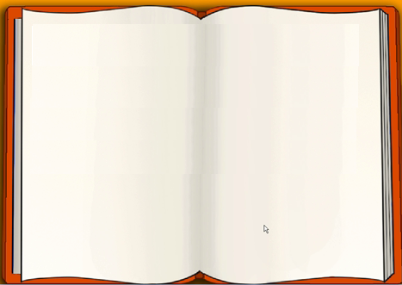

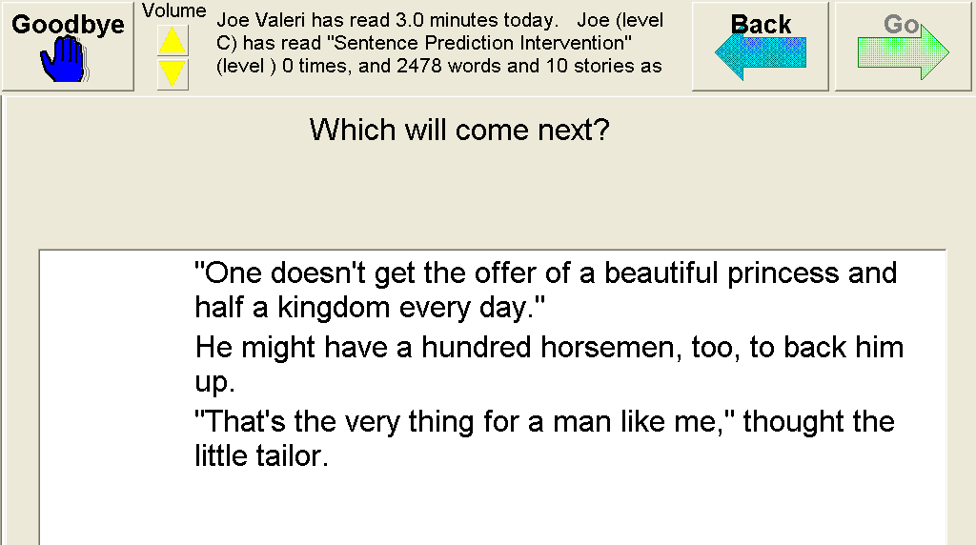
What can questions target?
Reading
  Decoding: In “Word Swap,” click on the “misread” word [Zhang ITS 08]
  Comprehension: Click on the missing word. [Mostow TICL 04]
  Inter-sentential prediction: Which will come next? [Beck ITS 04]
  Monitor: Did that make sense?
  Self-question: Why was the country mouse surprised? [Chen AIED 09]
  Disengagement: hasty guessing [Beck AIED 05]
Vocabulary
  Recall: Which means most like <word>? [Aist 01]
  Recognize: Which word means <definition>? [TICL 04]
  Remind: Definition cloze [Gates QG 11]
  Disambiguate: What does <word> mean here?
Knowledge
  Fact: Noiz arte du nahi duenak iritzia emateko aukera? [Aldabe QG 11]
  Skill: How many grams can a worker ant carry? [Williams QG 11]
  Concept: …
The lid sat in the loft.
was
Notes:
Speech-print correspondence: Which word was misread? [WordSwap]
UNTIL WHEN do those who want to do so have the opportunity to express their views?

Slide 4
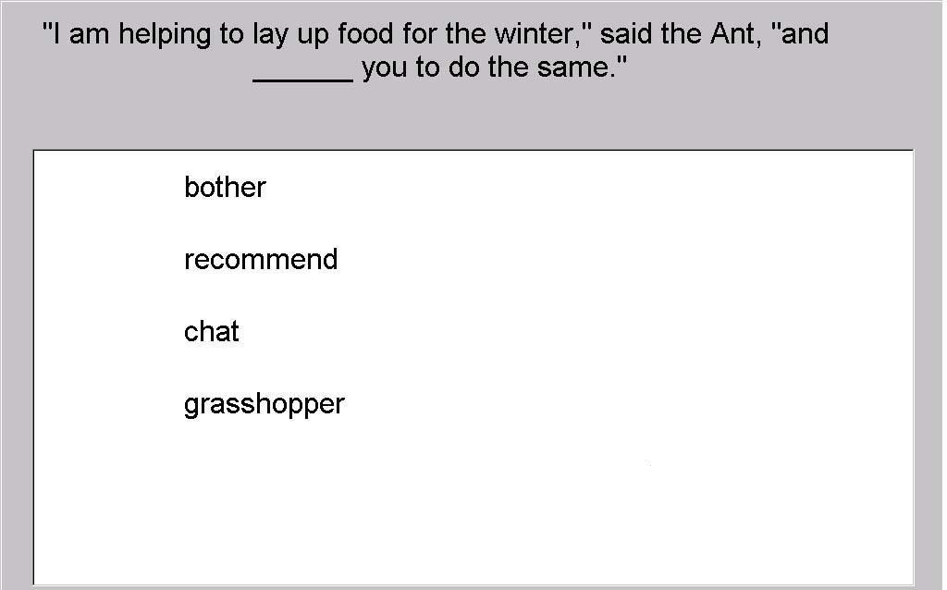
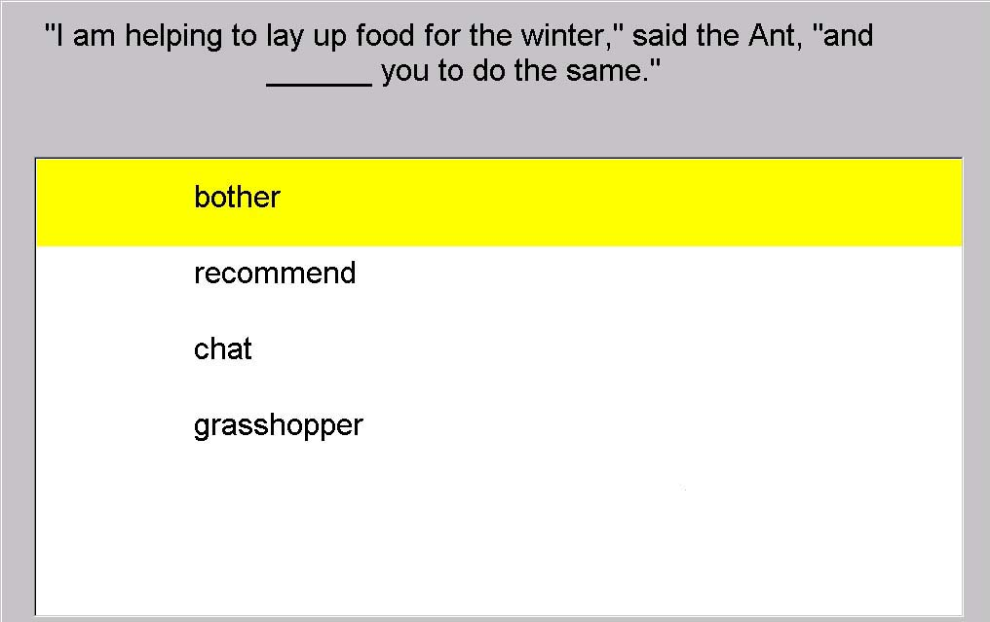
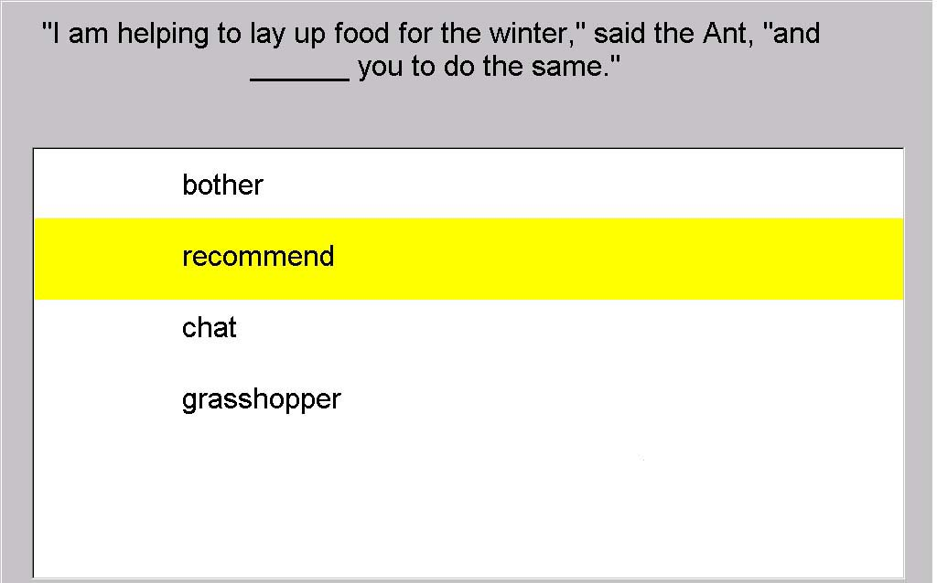
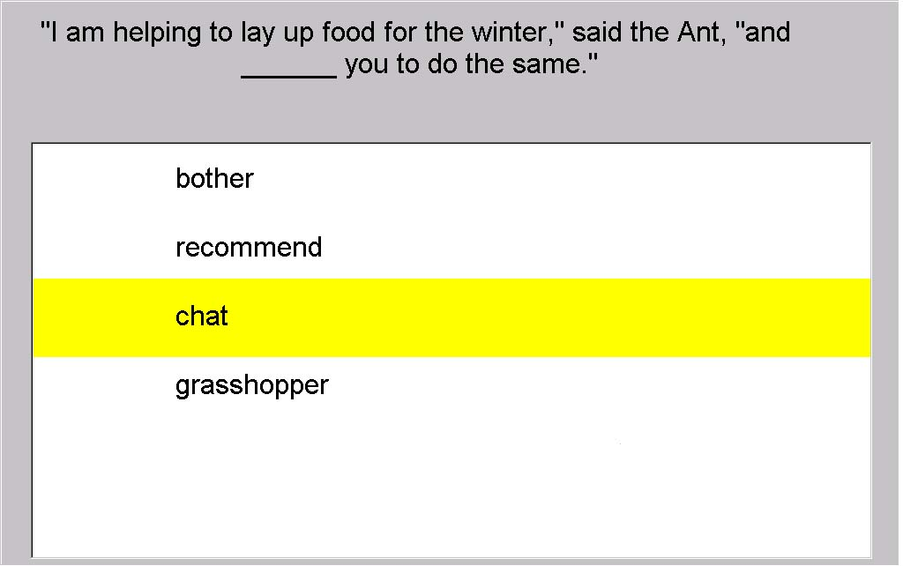
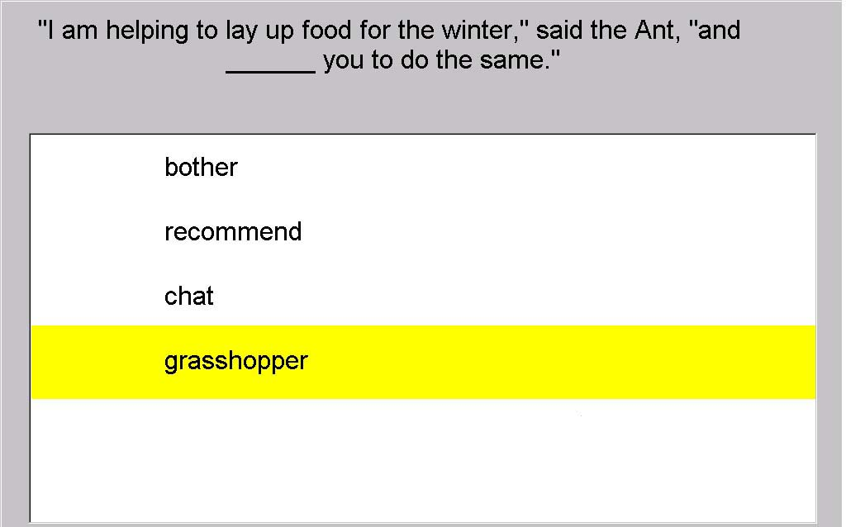
What can questions target?
Reading
  Decoding: In “Word Swap,” click on the “misread” word [Zhang ITS 08]
  Comprehension: Click on the missing word. [Mostow TICL 04]
  Inter-sentential prediction: Which will come next? [Beck ITS 04]
  Monitor: Did that make sense?
  Self-question: Why was the country mouse surprised? [Chen AIED 09]
  Disengagement: hasty guessing [Beck AIED 05]
Vocabulary
  Recall: Which means most like <word>? [Aist 01]
  Recognize: Which word means <definition>? [TICL 04]
  Remind: Definition cloze [Gates QG 11]
  Disambiguate: What does <word> mean here?
Knowledge
  Fact: Noiz arte du nahi duenak iritzia emateko aukera? [Aldabe QG 11]
  Skill: How many grams can a worker ant carry? [Williams QG 11]
  Concept: …
was
Notes:
Speech-print correspondence: Which word was misread? [WordSwap]
UNTIL WHEN do those who want to do so have the opportunity to express their views?

Slide 5
What can questions target?
Reading
  Decoding: In “Word Swap,” click on the “misread” word [Zhang ITS 08]
  Comprehension: Click on the missing word. [Mostow TICL 04]
  Inter-sentential prediction: Which will come next? [Beck ITS 04]
  Monitor: Did that make sense?
  Self-question: Why was the country mouse surprised? [Chen AIED 09]
  Disengagement: hasty guessing [Beck AIED 05]
Vocabulary
  Recall: Which means most like <word>? [Aist 01]
  Recognize: Which word means <definition>? [TICL 04]
  Remind: Definition cloze [Gates QG 11]
  Disambiguate: What does <word> mean here?
Knowledge
  Fact: Noiz arte du nahi duenak iritzia emateko aukera? [Aldabe QG 11]
  Skill: How many grams can a worker ant carry? [Williams QG 11]
  Concept: …
Notes:
Speech-print correspondence: Which word was misread? [WordSwap]
UNTIL WHEN do those who want to do so have the opportunity to express their views?

Slide 6
What can questions target?
Reading
  Decoding: In “Word Swap,” click on the “misread” word [Zhang ITS 08]
  Comprehension: Click on the missing word. [Mostow TICL 04]
  Inter-sentential prediction: Which will come next? [Beck ITS 04]
  Monitor: Did that make sense?
  Self-question: Why was the country mouse surprised? [Chen AIED 09]
  Disengagement: hasty guessing [Beck AIED 05]
Vocabulary
  Recall: Which means most like <word>? [Aist 01]
  Recognize: Which word means <definition>? [TICL 04]
  Remind: Definition cloze [Gates QG 11]
  Disambiguate: What does <word> mean here?
Knowledge
  Fact: Noiz arte du nahi duenak iritzia emateko aukera? [Aldabe QG 11]
  Skill: How many grams can a worker ant carry? [Williams QG 11]
  Concept: …
Notes:
Speech-print correspondence: Which word was misread? [WordSwap]
UNTIL WHEN do those who want to do so have the opportunity to express their views?

Slide 7
How has Project LISTEN used questions?
Assess comprehension [Mostow et al., TICL 04]
Help comprehension [Beck et al., ITS 04]
Assess engagement [Beck, AIED 05]
Teach self-questioning [Mostow & Chen, AIED 09]
Model self-questioning [Chen et al., ITS 10]
Assess self-questioning [Chen et al., QG 11]
Help vocabulary learning [Gates et al., QG 11]

Slide 8
1. Assess comprehension [TICL 04]
Target: comprehend sentence
Purpose: assess comprehension while reading
Source: sentence in text
Question type: cloze
Answer type: multiple choice among 4 words from text
Generation: randomly pick sentence, word, and distracters
Modality: play recorded sentence and words; click on one
Assessment: original word? immediate correctness feedback
Evaluation: correlate against standard comprehension test
Notes:
Examples:
Assess comprehension: M/C cloze (TICL)
\listen\Documentation\Papers\ITS2002\ITS talks\ITS2002-cloze-assessment-with-animation.ppt
Assess vocab: Aist; matching (TICL)
Assist comprehension
2004 vocab WSD
Generic Wh → 3Wh-
Sentence ordering
Remind taught item (Gates QG2011)
Assess engagement (Beck)
Model [in both senses] self-questioning (Chen)

Slide 9
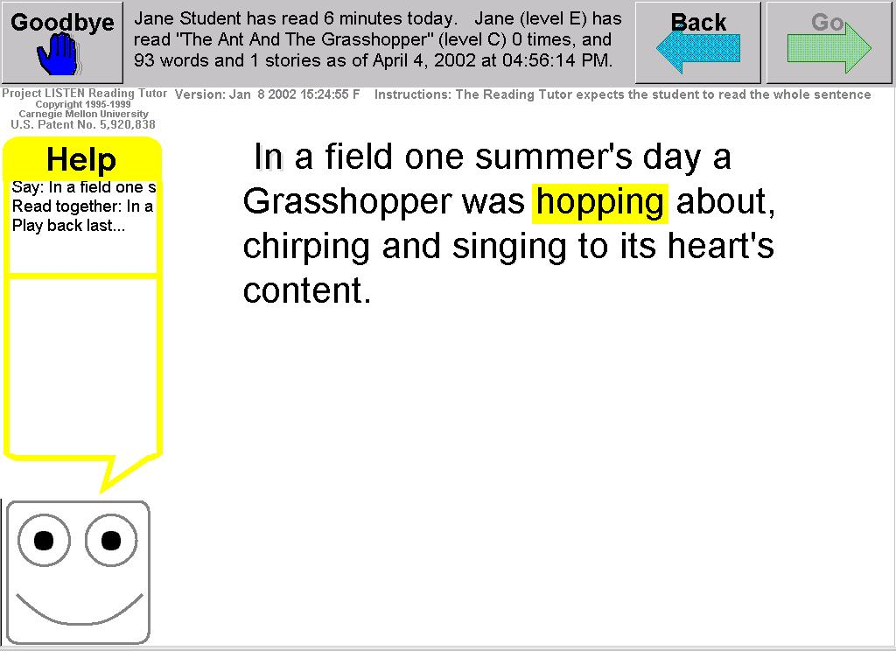
Student starts reading a story…

Slide 10
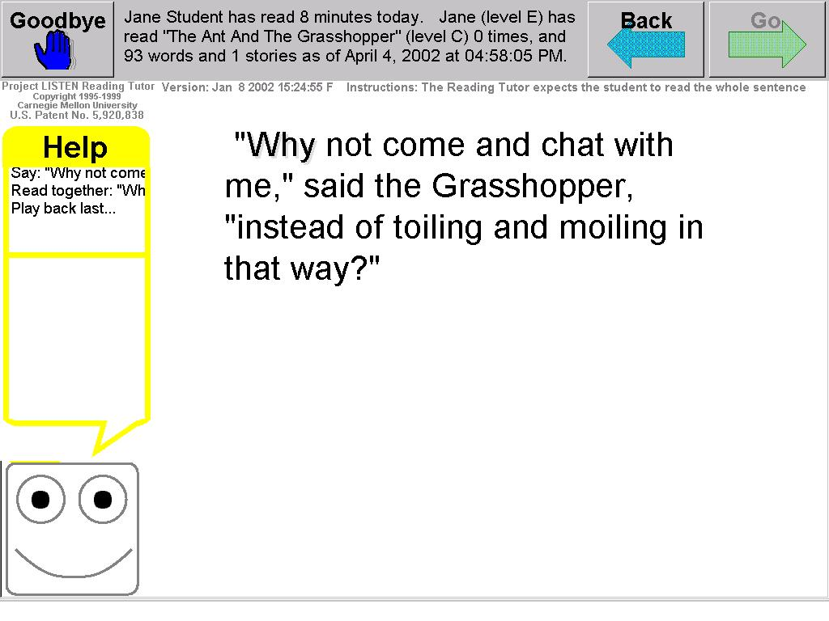
Now and then during the story…

Slide 11
insert a cloze question…
  Reading Tutor reads question and choices aloud
  Target and distracters are words from same story

Slide 12
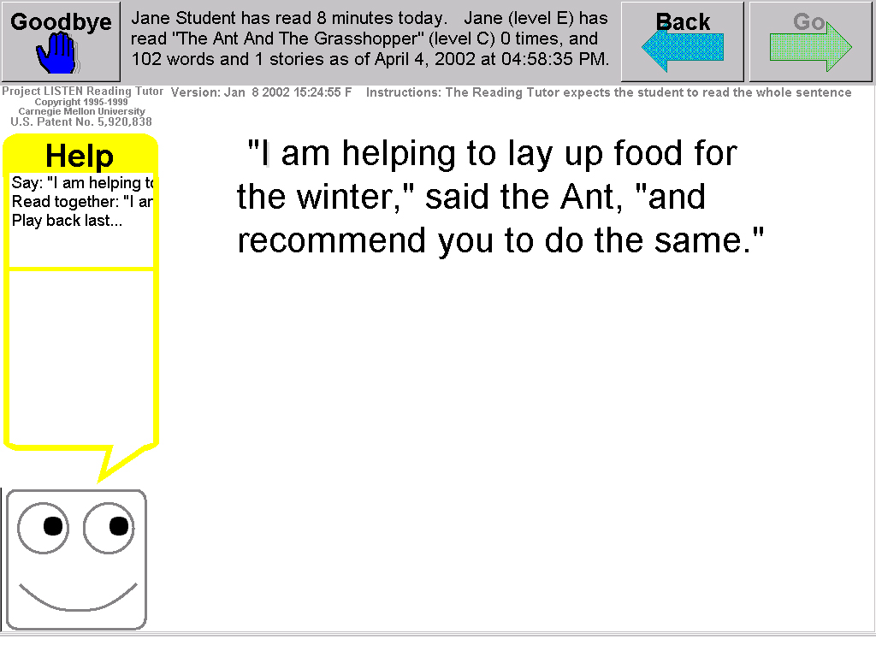
… just before a sentence.

Slide 13
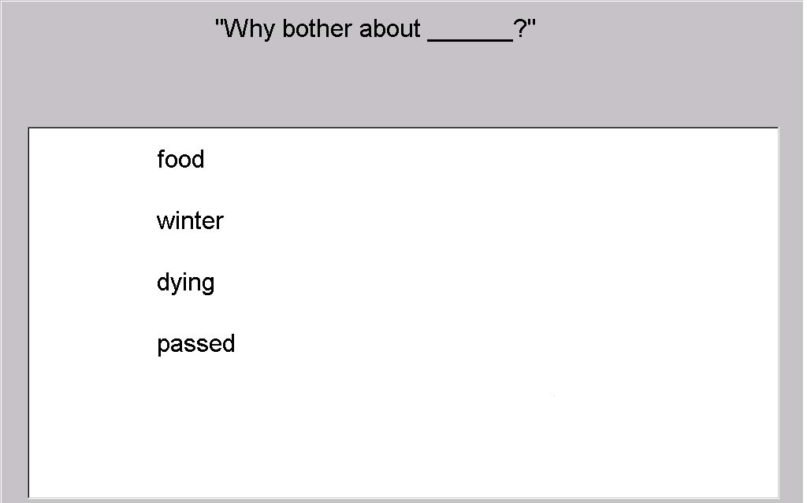
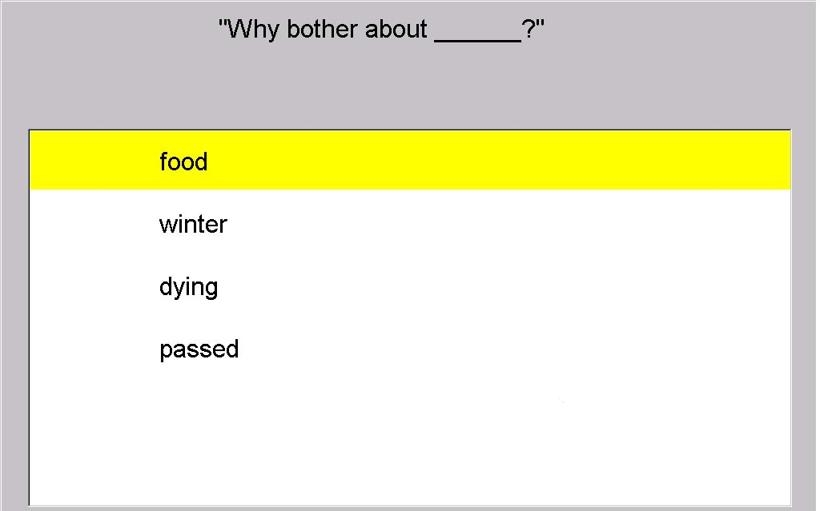
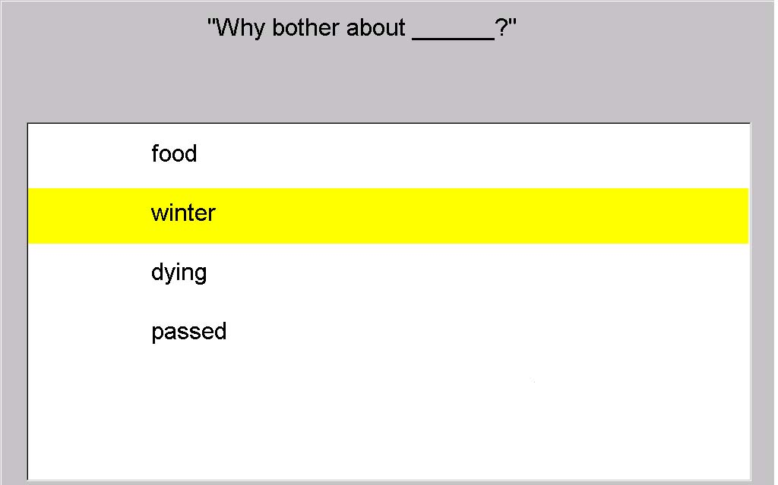
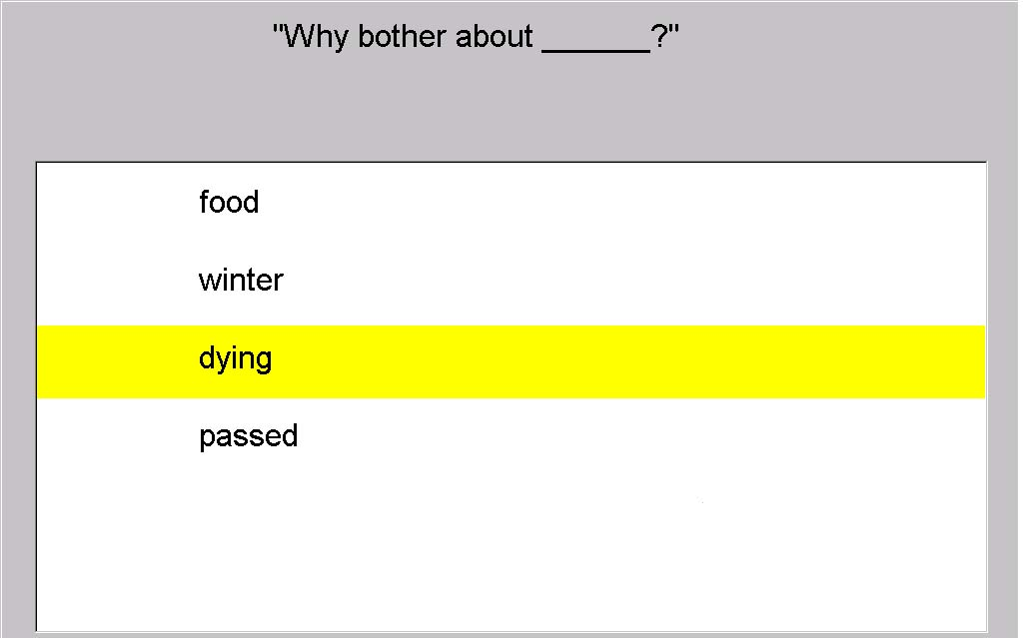
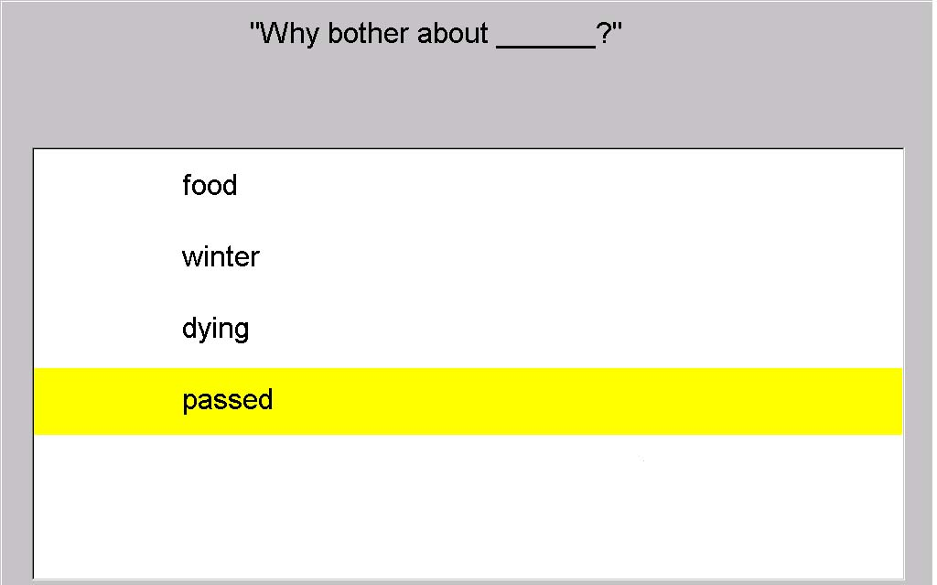
What do cloze questions test?

Slide 14
Oct.01 – Mar.02 evaluation data
Reading Tutor asked 69,326 automated cloze questions
  364 students in grades 1-9 at 7 schools
  20-758 questions per student (median 136)
  98% of questions answered – else Goodbye, Back, or timeout
  24-88% correct (median 61%); 25% = chance
How much guessing? Hasty responses [J. Valeri]:
  3,078 (4.5%) faster than 3 seconds, only 29% correct
  3.9% per-student mean, but below 1% for most students
  Guessing rose from 1% in October to 11% by March

Slide 15
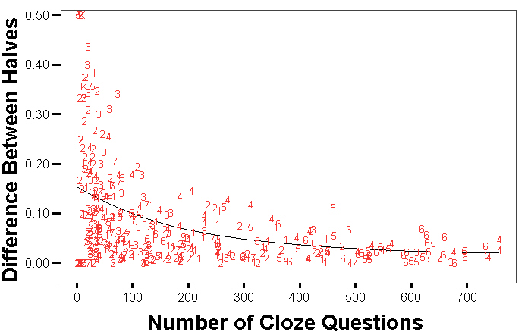
Reliability: Guttman split-half test
Split N responses into two halves
  Match by word and story level
Reliability increases with N
  .83 for N≥10 (338 students)
  .95 for N≥80 (199 students)
Grade = 1..9

Slide 16
What affects cloze difficulty?
Similarity of distracters to answer
  Part of speech [Hensler & Beck, ITS 06]
  Semantic class
  Consistency with local context
  Consistency with inter-sentential context
Vocabulary level of answer and distracters
  “Sight words” = 225 most frequent words of English [Dolch list]
  “Easy words” = 226…3,000
  “Hard words” = 3,001…25,000
  “Defined words” = marked as warranting explanation
Text level of story
  Grade K, 1, 2, 3, 4, 5, 6, 7
Cloze performance at 4 word levels x 8 text levels predicts Woodcock Reading Mastery Test comprehension (R = .84)

Slide 17
2a. Help comprehension [ITS 04]
Target: comprehend text by questioning
Purpose: scaffold comprehension while reading
Source: none
Question type: Wh-
Answer type: multiple choice
Generation: scripted generic questions and choices
Modality: play recorded prompt and words; click on one
Assessment: none
Evaluation: test efficacy on ensuing cloze performance
Notes:
Examples:
Assess comprehension: M/C cloze (TICL)
\listen\Documentation\Papers\ITS2002\ITS talks\ITS2002-cloze-assessment-with-animation.ppt
Assess vocab: Aist; matching (TICL)
Assist comprehension
2004 vocab WSD
Generic Wh → 3Wh-
Sentence ordering
Remind taught item (Gates QG2011)
Assess engagement (Beck)
Model [in both senses] self-questioning (Chen)

Slide 18
Generic Wh- questions: initial
Generic prompt (meta-question):
  Click on a question you can answer, or click Back to reread the sentence
Generic 1-word questions as choices:
  Who? What? When? Where? Why? How? So?
Evaluation: failed 2002 user test
  Meta-question confusing
  1-word questions too vague to map to text

Slide 19
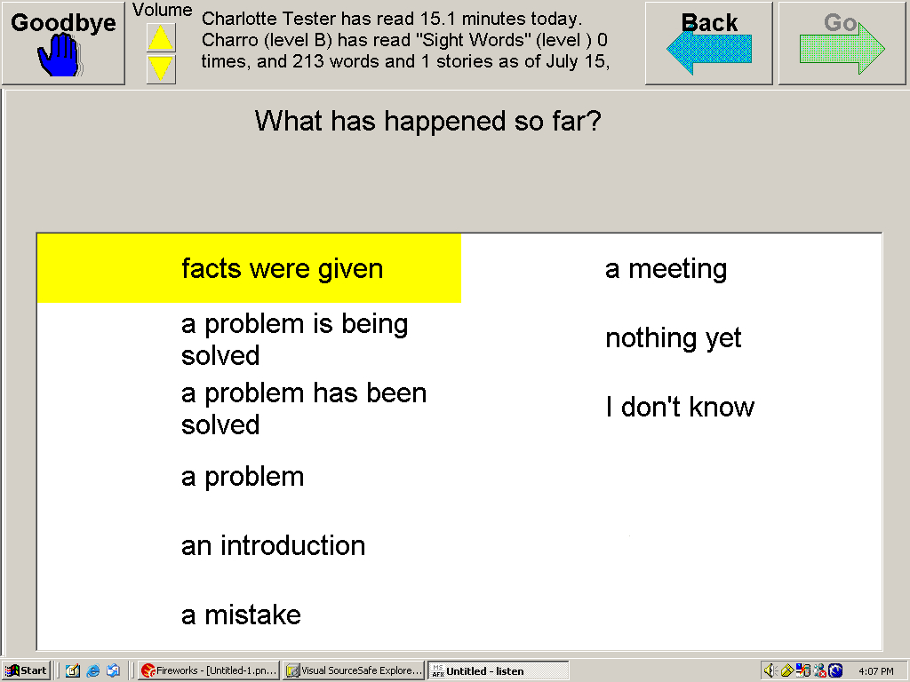
Generic Wh- questions: revised
Randomly pick a generic prompt
  What has happened so far? When does this take place? …
List choices scripted for the prompt
  facts were given; a problem is being solved; …
  in the present; in the future; in the past; It could happen in the past; I can’t tell

Slide 20
2b. Help comprehension [ITS 04]
Target: comprehend text by predicting
Purpose: scaffold comprehension while reading
Source: none
Question type: Which will come next?
Answer type: multiple choice
Generation: answer = next sentence; distracters = 2 following
Modality: play recorded prompt and sentences; click on one
Assessment: original sentence? immediate correctness feedback
Evaluation: 41% right; test efficacy on ensuing cloze performance
Notes:
Examples:
Assess comprehension: M/C cloze (TICL)
\listen\Documentation\Papers\ITS2002\ITS talks\ITS2002-cloze-assessment-with-animation.ppt
Assess vocab: Aist; matching (TICL)
Assist comprehension
2004 vocab WSD
Generic Wh → 3Wh-
Sentence ordering
Remind taught item (Gates QG2011)
Assess engagement (Beck)
Model [in both senses] self-questioning (Chen)

Slide 21
Sentence prediction

Slide 22
2003 evaluation data
Reading Tutor asked 23,372 randomly inserted questions
  252 students in grades 1-4+? who used for an hour or more
  6,720 generic what, when, where
  1,865 Which will come next? sentence prediction
  15,187 cloze
  On average, one question every 10 sentences

Slide 23
Evaluation results
Variable | Helps/Hurts | p
# 3W questions | ☺ | 0.023
# sentence predictions | ☺ | 0.072
# cloze questions | =
# recent 3W questions | ☹ | 0.074
# recent cloze questions | =
Time since prior question (sec) | ☺ | 0.036
Time since start of story (sec) | ☹ | 0.14

Slide 24
Effect of recent questions
Proportion of hasty responses
Time since previous question (sec)
Response time < 3 sec indicates disengagement
Use to track (dis-)engagement [Beck AIED 05]

Slide 25
Effect of question type
Cloze performance
Number of prior questions

Slide 26
QG costs (lowest → highest)
 | None | Trivial | Simple | Complex | Manual
Generation
Question |  | Generic | Cloze | NLP | Scripted
Answer | None | Given | = text | NLP | Scripted
Distracter | None | Generic | From text | NLP | Scripted
Modality
Output |  | Menu | Text | TTS, visual | Prerecorded
Input | None | Click | Keyboard | ASR, gesture | Transcribed
Assessment
Scoring | None | M/C | = answer | NLP | Manual
Feedback | None | Generic | answer | NLP | Scripted
Generation
Question
Answer
Distracter
Modality
Output
Input
Assessment
Scoring
Feedback
Target: What does it take to answer the questions?
Purpose: Why ask the questions?
Question type: cloze? wh-/how/so/…? find/compare/…?
Answer type: multiple choice? fill-in? open-ended?
Generation: How construct questions, answers, distracters?
Modality: menu? click? keyboard? speech? graphics? …
Assessment: How score answers? How generate feedback?
Evaluation: How to tell how well questions serve purpose?
Generation
Modality
Assessment
Notes:
Source: what is question about? from text/database/…?

Slide 27
QG costs (lowest → highest)
2b. Sentence prediction
7. Vocabulary reminders
2a. Generic Wh-
1. M/C cloze
 | None | Trivial | Simple | Complex | Manual
Generation
Question |  | Generic | Cloze | NLP | Scripted
Answer | None | Given | = text | NLP | Scripted
Distracter | None | Generic | From text | NLP | Scripted
Modality
Output |  | Menu | Text | TTS, visual | Prerecorded
Input | None | Click | Keyboard | ASR, gesture | Transcribed
Assessment
Scoring | None | M/C | = answer | NLP | Manual
Feedback | None | Generic | answer | NLP | Scripted

Slide 28

?

